Slide 1
Fuel Efficiency Prediction and Analysis for Automotive Insights
-Mayur Shetty

Slide 2
Introduction
Our focus in our examination of fuel efficiency prediction is on finding the critical automotive characteristics that have a major impact on fuel efficiency. Through efficient handling of outliers and missing numbers, we guarantee data integrity. Using exploratory data analysis, patterns and correlations within the dataset are revealed, which inform the selection of features for our prediction model according to their significance and relevance. We assess several machine learning methods, emphasizing how accurate and consistent they are in predicting fuel economy. We employ Power BI to generate interactive visuals that elucidate the connections between various features and fuel economy to deliver our results to the audience successfully. This approach makes the data insights more approachable and captivating.

Slide 3
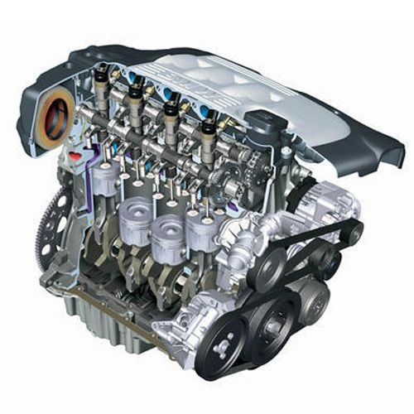

Agenda
To find the key factors influencing the fuel efficiency of the vehicle.
To find useful insights for the motor vehicle industry.
Topics covered in the project-
Data Loading.
Pre-processing of the data.
Exploratory Data Analysis (EDA).
Model Selection.
Evaluation Metrics.

Slide 4
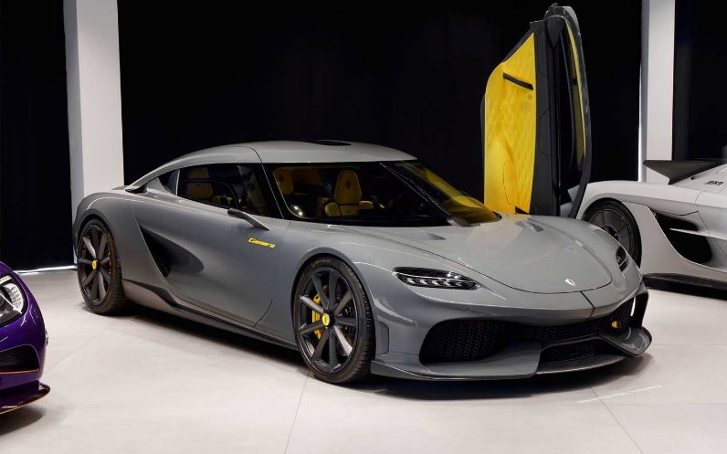
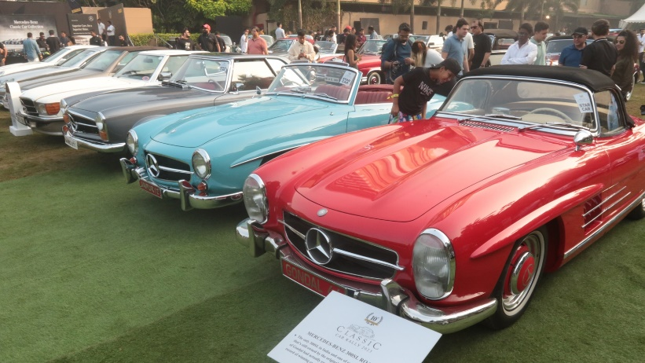






Data Fields in the data.
mpg: Car's fuel efficiency measured in miles per gallon.
cylinders: Number of cylinders in the car's engine.
displacement: Engine displacement in cubic inches.
horsepower: Engine power output measured in horsepower.
weight: Car's weight in pounds.
acceleration: Time taken for the car to reach a certain speed from standstill.
model_year: Year of manufacturing or model release.
origin: Country of origin or manufacture of the car.
car_name: Unique identifier for each car instance.

Slide 5
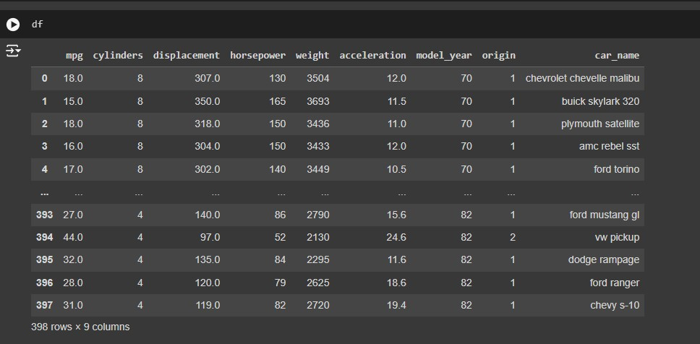
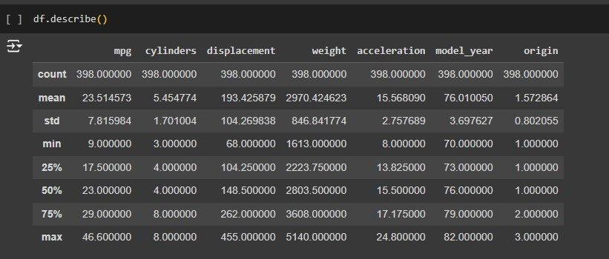
Data Structure and Description
There are 389 columns and 9 rows in the data.
The data belongs to vintage cars as the year of manufacturing is between 1970-1982.
There are vehicles that have 3 cylinders to a range of 8 cylinders.
The mpg column is our dependent variable('y’).
The displacement column is the CC of the vehicle which ranges from 68CC up to 455 CC.
The weight of the car would play an important role as the more the weight of the car more the fuel would be required to run it.

Slide 6
Pre-Processing
1) Dropping unnecessary features-
We would drop the ‘car_name’ feature as they have no actual effect on the dataset and would falsely affect the predictions of the data.
There are no other features which are needed to be dropped from the data-set.

Slide 7
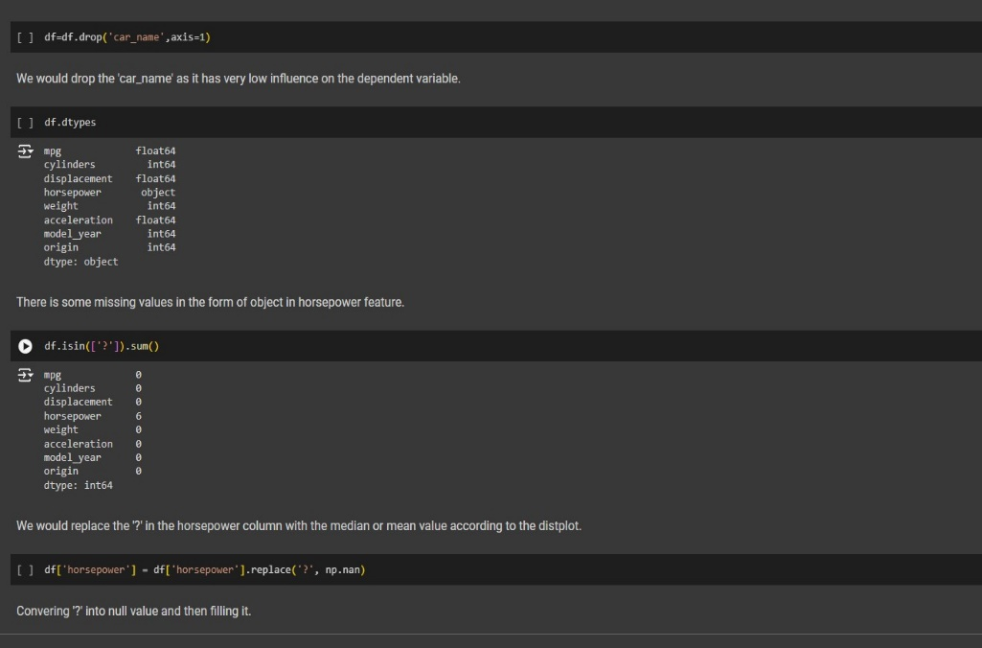
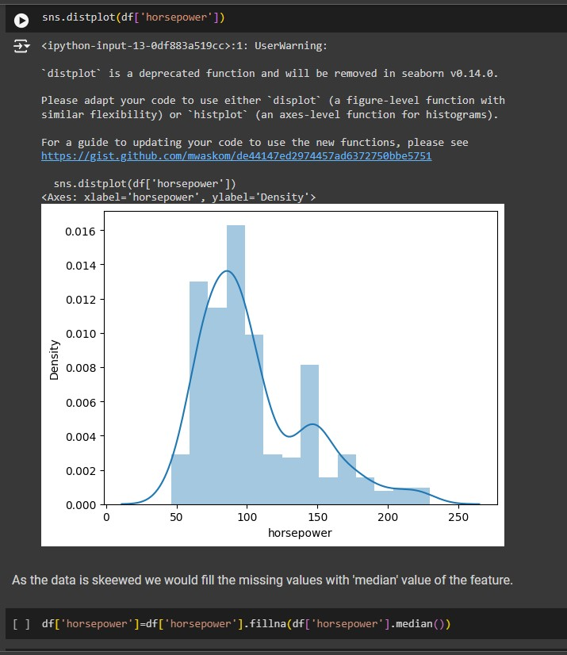
Pre-Processing
2) Horsepower feature-
The horsepower feature had ‘?’ in three rows which were filled as ‘nan’ values using the NumPy library, and then the nan values were filled with median values as the feature was right-skewed.
The columns in the missing values were filled because the data had a very low number of rows.

Slide 8
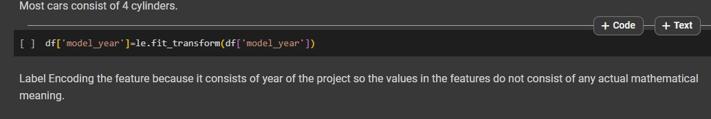
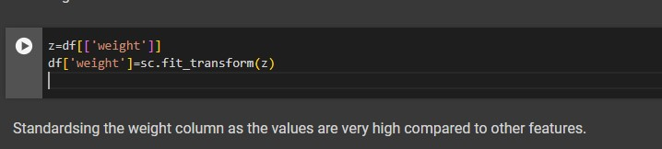
Pre-Processing
3) Label Encoding categorical columns-
Label Encoding the ‘model_year’ feature because it consists of the manufacturing year of the vehicle so the values in the features do not consist of any actual mathematical meaning of its own.
4) Standardizing columns-
Standardizing the weight column as the values are very high compared to other columns.

Slide 9
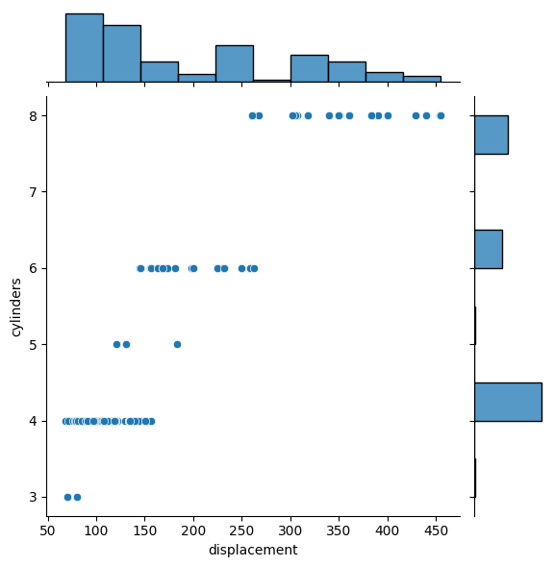
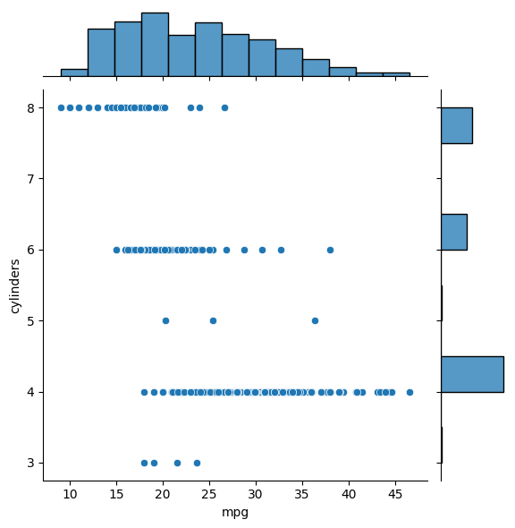
Exploratory Data Analysis (EDA)
As the number of cylinders increases, the displacement also rises. Therefore, we can conclude that the number of cylinders is positively correlated with the vehicle's displacement.
As the number of cylinders increases, the mileage of the vehicles decreases. This indicates that the 'y' variable is negatively correlated with the number of cylinders.

Slide 10
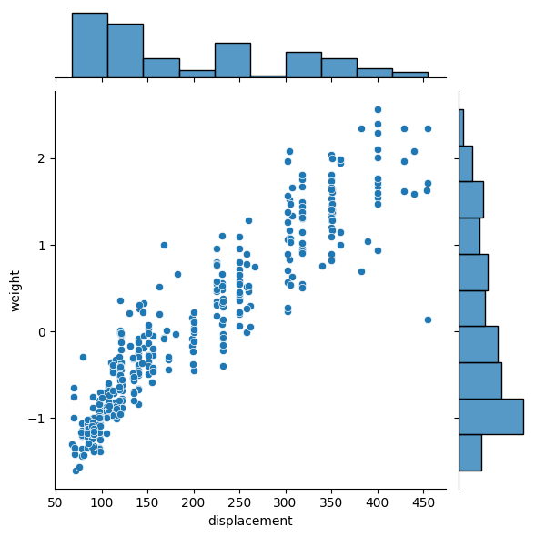
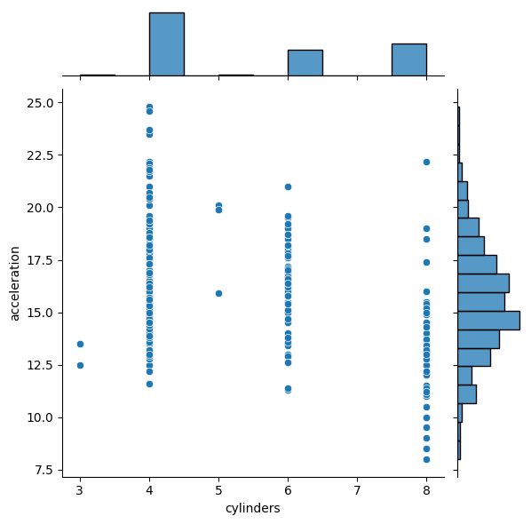
Exploratory Data Analysis (EDA)
The displacement of the vehicle increases as the weight of the vehicle increases. As the weight of the vehicle is low and displacement was high from the above table we can say that the acceleration also decreased in higher displacement vehicles because their weights were heavy.
The acceleration of the vehicle doesn't have any direct relation with the number of cylinders in the vehicle.4 cylinder vehicles have the best acceleration in all of the others.

Slide 11
Model selection and Evaluation Metrics
Linear Regression-
Achieved an accuracy of 84% using the R2_score evaluation metrics
Artificial Neural Network-
Achieved an accuracy of 86% using the R2_score evaluation metrics
Support Vector Machine-
Achieved an accuracy of 82% using the R2_score evaluation metrics
The data is linear and of a normal range so we used the Support Vector Machine algorithm with ‘linear’ kernels to find predictions in the data.
To achieve a high level of accuracy with continuous training of the data.
The data is linear and of a normal range. Hence we used the Linear Regression algorithm.

Slide 12
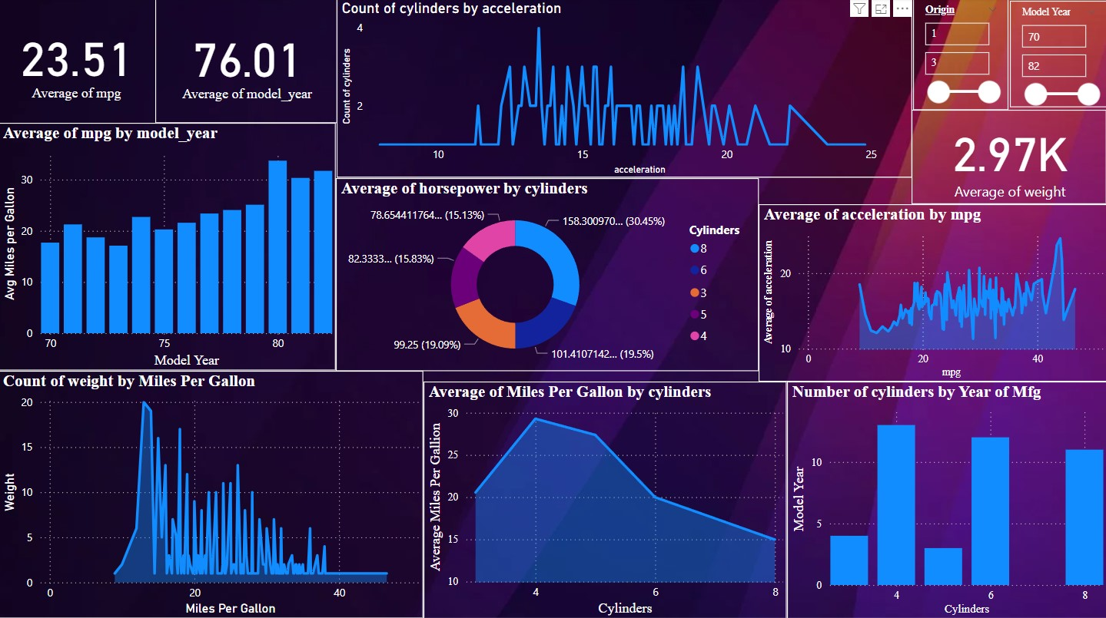
Power-BI Dashboard

Slide 13
Findings from the Power-BI Dashboard
The average fuel efficiency of the vehicles is 23.5 miles per gallon.
Most cars in the dataset belong to the year 1971.
The horsepower of the cars increased as the number of cylinders increased.
The model of the cars has a positive correlation with the mileage of the vehicle, As the year of the model increased the mileage of the cars increased as well.
The average weight of the cars was around 2970 kgs.
The higher the weight of the vehicle, the lower the fuel efficiency of the vehicle.
4-cylinder vehicles provided the best fuel efficiency of all the other vehicles.
The average of the vehicles decreased as the number of cylinders increased.

Slide 14
Thank You!

